Slide 1
Write Simple Operating System from Scratch
Students:
Seham Nasr
Esra'a Faoury
Raghad Rabi
Advanced Operating Systems Project

Slide 2
OUR
Project
Introduction
01
Writing a Simple Operating System | from
Scratch (by Nick Blundell)
Phase one (16-bit Real mode)
02
16-bit Real mode, Boot sector code,
Print string code.
Phase two (32-bit Protected mode)
03
32-bit Protected mode, GDT, Boot sector,
Switch to PM, Print string PM, Disc load,
Kernel, Entry kernel
Bootable USB
04
Boot from USB in Phase one, Bootable from USB in Phase two

Slide 3
Introduction
Writing a Simple Operating System | from Scratch
(by Nick Blundell)

Slide 4
Introduction
Writing a Simple Operating System | from Scratch (by Nick Blundell)
We've all used an operating
system (OS) before (e.g.
Windows XP, Linux, etc.), and perhaps we have even written some programs to run on one.
today, we take a lot for granted about how these wonderful
machines actually work
underneith all those layers of
software that commonly come bundled with them and which
are required for thir day-to-day usefulness.
Here, concentrating on the
widely used x86 architecture
CPU, we will strip bare our
computer of all software and
follow in Doug's early footsteps, learning along the way about:
01
02
03
How a computer
boots?
How to write low –
level programs in the barren landscape
where no operating
system yet exists?
How to configure the CPU so that we can begin to use its
extend functionality?
04
05
How to bootstrap code written in a higher-level language?
How to create some
fundamental operating system services?

Slide 5
Computer Architecture and the
Boot Process
The Boot Process
When we reboot our computer, it must start up again,
initially without any notion of an operating system. Luckily, we have (BIOS). Reads the boot sector into memory, and
instructs the CPU to begin executing the first boot sector
BIOS, Boot Blocks, and the Magic
Number
CPU Emulation
last two bytes of an intended boot sector
must be set to the magic number 0xaa55,
we can test our program in two ways:
1) Virtual machine. 2) Our current operating system.
Testing these low-level programs without
continuously having to reboot a machine or
risk scrubbing your important data off a disk,
and that is to use a CPU emulator such as
Bochs or QEmu.
1) $bochs
2) $qemu <your-os-boot-disk-image-file>
The Usefulness of Hexadecimal Notation
strings of bits are rather long-winded to write out but are much easier to convert to and from the more shorthand hexadecimal notation, essentially because we can break the conversion down into smaller, 4-bit segments of the binary number.

Slide 6
Phase one
Boot Sector Programming (in 16-bit Real Mode)

Slide 7
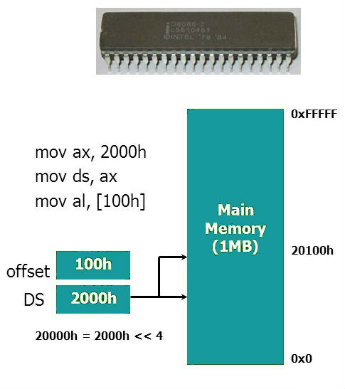

16-bit Real mode
Real mode is an operating mode that enables the Intel 286
and newer processors to take on the attributes of the lower
8086 or 8088 processors, allowing them to run older software
programs. Real mode offers a higher clock speed, but limits
the processor to only use 16-bit instructions and a minimum of 1 MB of RAM (20-bit). For example, legacy MS-DOS operating systems run programs in real mode.
In this Phase we will write our first
simple operating system from scratch in 16-bit real mode..
How shall we do?

Slide 8

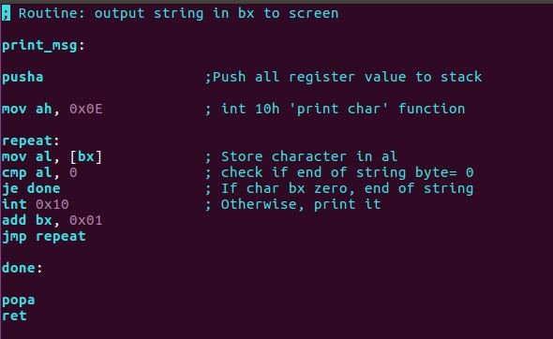
This is our print string assembly code
Code Features :
1-self-contained Function (call –ret)
2-instructions, pusha and popa, that push and pop all registers to and from the stack respectively.
3-printing is char by char (loop) [repeat, cmp , je , jmp repeat]
Why it is important to use pusha and popa?

Slide 9
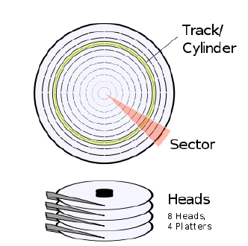
Boot sector
We create a boot sector code written in assembly language.
BIOS must read specific sectors of data (usually 512 bytes in size) from specific physical locations of the disk devices. (cylinder , sector , head)
So, the easiest place for BIOS to find our OS is in the first sector of the disk.

Slide 10
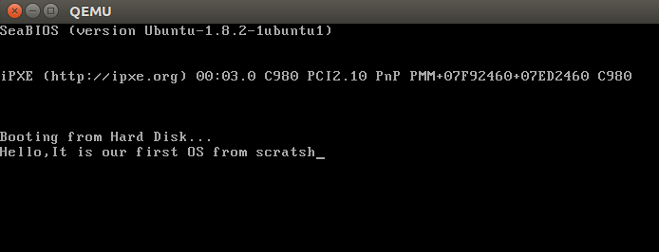
Running the previous code
By writing this command on terminal
$qemu boot sect.bin

Slide 11
Phase Two
32-bit Protected mode

Slide 12
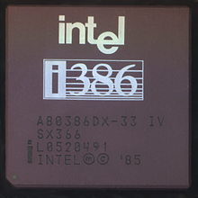
32-bit protected mode
In order to make fuller use of the CPU, and to better
understand how developments of CPU architectures
can benefit modern operating systems, namely
memory protection in hardware, then we must press on into 32-bit protected mode.

Slide 13

Cont.
The main differences between 32-bit protected mode and 16-bit real mode are:
Registers are extended to
32 bits, with their full capacity
being accessed by pre-fixing
an e to the register name, for
example: mov ebx, 0x274fe8fe
4) Interrupt handling is
also more sophisticated.
5) The CPU supports a more
sophisticated (though slightly more complex) means of
memory segmentation, which
offers two big advantages:
2) For convenience, there are two additional general purpose segment register fs and gs.
* Code in one segment can be
prohibited from executing code in a more privileged segment.
* The CPU can implement virtual memory for user processes, such that pages (i.e. fixed-sized chunks) of a process's memory can be
swapped transparently between
the disk and memory on an
as-needed basis.
3) 32-bit memory offsets
are available, so an offset can reference a whopping 4 GB of memory (0xffffffff)

Slide 14
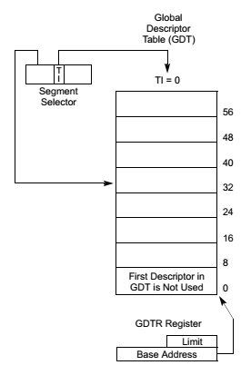
GDT
Global descriptor table
Understanding the Global Descriptor Table
The Main part about switching the CPU from 16-bit real mode into
32-bit protected mode is that we must prepare a complex data
structure in memory called the global descriptor table (GDT), which
defines memory segments and their protected-mode attributes. Once we have defined the GDT, we can use a special instruction to load it
into the CPU, before setting a single bit in a special CPU control
register to make the actual switch.
This process would be easy enough if we didn't have to dene the
GDT in assembly language, but sadly this low-level switch-over is
unavoidable if we later wish to load a kernel that has been compiled
from a higher-level language such as C, which usually will be
compiled to 32-bit instructions rather than the less-efficient 16-bit
instructions.
We can no longer use BIOS once switched into 32-bit protected mode If you thought making BIOS calls was low-level. This is like one step
backwards, two steps forwards.

Slide 15
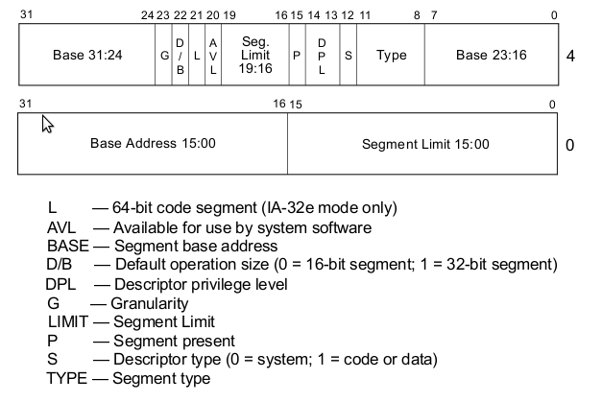
Cont.
Global descriptor table
Our code segment will have the following configuration:
1) Base: 0x0
2) Limit: 0xf
3) Present: 1, since segment is present in memory - used for virtual memory
4) Privilige: 0, ring 0 is the highest privilige.
5) Descriptor type: 1 for code or data segment, 0 is used for traps
6) Type:
* { Code: 1 for code, since this is a code segment
* { Conforming: 0, by not corming it means code in a segment with a
lower privilege may not call code in this segment - this a key to
memory protection
* { Readable: 1, 1 if readable, 0 if execute-only. Readable allows us to
read constants defined in the code.
*{ Accessed: 0 This is often used for debugging and virtual memory
techniques, since the CPU sets the bit when it accesses the segment

Slide 16
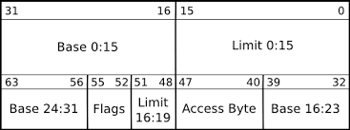
Cont.
Global descriptor table
7) Other flags:
* { Granularity: 1, if set, this multiplies our limit by 4 K (i.e. 16*16*16), so our 0xf
would become 0xf000 (i.e. shift 3 hex digits to the left), allowing our segment to
span 4 Gb of memory
* { 32-bit default: 1, since our segment will hold 32-bit code, otherwise we'd use 0 for 16-bit code. This actually sets the default data unit size for operations (e.g. push 0x4 would expand to a 32-bit number ,etc.)
* { 64-bit code segment: 0, unused on 32-bit processor
* { AVL: 0, We can set this for our own uses (e.g. debugging) but we will not use
Since we are using a simple at model, with two overlapping code and data
segments, the data segment will be identical but for the type flags:
1) Code: 0 for data
2) Expand down: 0 . This allows the segment to expand down – TODO explain this
3)Writable: 1. This allows the data segment to be written to, otherwise it would be read only
4)Accessed: 0 This is often used for debugging and virtual memory techniques,
since the CPU sets the bit when it accesses the segment.

Slide 17
Switch to 32 protected mode
BIOS routines, having been coded to work only in 16-bit real mode, are no longer valid in 32-bit protected mode; indeed, attempting to use them would likely crash the machine.
So what this means is that a 32-bit operating system must provide its own drivers for all hardware of the machine
32 bit PM
16-bit RM
It can be, but that will reduce performance

Slide 18
So how to print on to screen?
What is displayed on the screen is a visual representation of a specific range of memory. So, in order to manipulate the screen, we must manipulate the specific memory range that it is using in its current mode.
each character cell of the screen is represented by two bytes in memory: the first byte is the ASCII code of the character to be displayed, and the second byte encodes the characters attributes.
32-bit protected mode routine writes directly to video memory
If we’d like to display a character on the screen, then we need to set its ASCII code and attributes at the correct memory address for the current Video Graphics Array (VGA( mode, which is usually at address 0xb8000.
Routine is always prints the string to the top-left of the screen

Slide 19
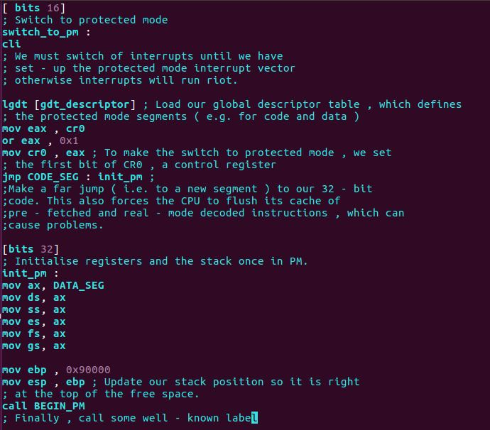

Slide 20
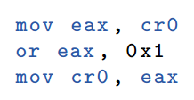
Cont.
After GDT and the GDT descriptor prepared, instruct the CPU to switch from
16-bit real mode into 32-bit protected mode.
***Steps to switch:
1-disable interrupts using the cli (clear interrupt) instruction (Why?!)
2-Load the Global Descriptor Table with segment descriptors suitable for code, data, and stack.
lgdt [ gdt_descriptor ] “single instruction ” 3- set the first bit of a special CPU control register, cr0 to 1 “PM” if cr0 set to 0 then it will be in “RM” as follow:

Slide 21
Cont.
Issue a far jump, which will force the CPU to flush the pipeline jmp CODE_SEG : init_pm
Update all of the other segment registers so they now point to our 32-bit data
segment and update the position of the stack.

Slide 22
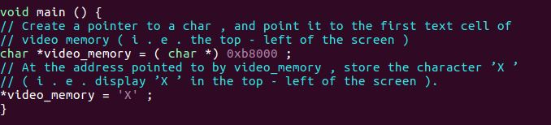
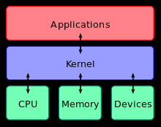
Kernel
$gcc -ffreestanding -c kernel.c -o kernel.o $ld -o kernel.bin -Ttext 0x1000 kernel.o --oformat binary
So, What is the benefit of ffreestanding?
What is 0x1000??

Slide 23
Cont.
Kernel will store in disk sector 0 and then booting by boot_Sector.asm
We can boot the kernel by BIOS, but it will be harder because we must write HDD or floppy to be compatible.

Slide 24
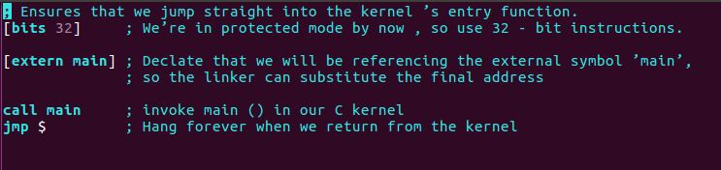
Kernel_entry
Kernel_Entery is a very simple assembly code used as a trick to enter the Kernel correctly “since boot-strapping will execute the instructions in order regardless the calling function from main as we know before, so we need to use a tricky way to enter the Kernel”
Kernel Entry main purpose is to call the enetry function of the kernel
Link Kernel with Kernel entry:
$ld -o kernel.bin -Ttext 0x1000 kernel entry.o kernel.o --oformat binary The option -f elf tells the assembler to output an object file of the particular format Executable and Linking Format (ELF), which is the default format output by out C compiler.

Slide 25
include all our routines into a boot sector that switch from 16-bit real mode into 32-bit protected mode.
Bootstrap our kernel from the disk.
when the computer boots , BIOS will load only boot sector (the first 512 bytes of the disk), not our kernel,
we can use the BIOS disk routines to have boot sector load additional sectors from a disk.
after we switch into protected mode, the lack of BIOS will make it hard for us to use the disk: we would have to write hard disk driver .
To simplify the problem of which disk and from which sectors to load the kernel code, the boot sector and kernel of an operating system can be grafted together into a kernel image, which can be written to the initial sectors of the boot disk.
Once we have compiled the boot sector, we can create our kernel image with this command:
cat boot sect.bin kernel.bin > os-image

Slide 26
Disk loader BIOS routine
A helpful routine that will simply read the first n sectors following the boot sector from a specified disk device.

Slide 27
Bootable USB

Slide 28
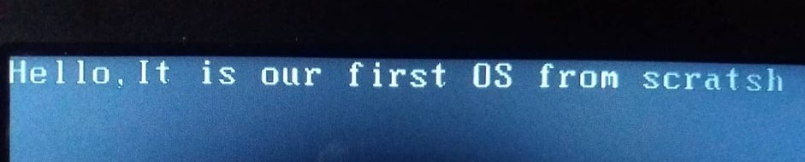
Bootable USB phase One
By using the following commands on UBUNTU terminal
- Format a USB drive .
1- Find USB flash path
$lsblk
2- Format USB flash with FAT32
$sudo mkfs -t vfat -I /dev/sdb
3- Install the boot sector on the USB drive.
$sudo umount /dev/sdb
$sudo dd if=myos.bin of=/dev/sdb && sync

Slide 29




Bootable USB phase two
Command & Virtual machine
HxD Tool
Bootable USB
Tools to boot from USB
We use different canid of tools and command to make USB bootable.
PowerISO
WinISO
ImgBurn

Slide 30
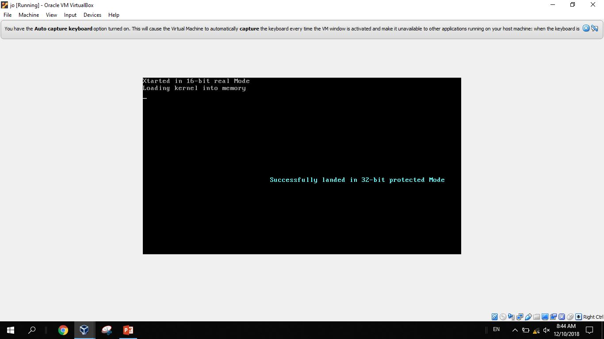
Commands and virtual machine
sudo mkfs –t vfat -I /dev/sdb
sudo umount /dev/sdb
sudo dd if=os-image of=/dev/sdb && sync

Slide 31
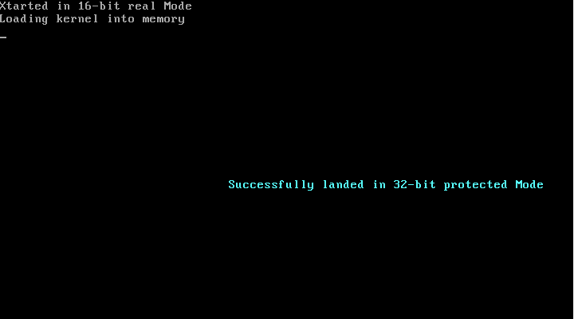
Run the boot sector using emulator

Slide 32
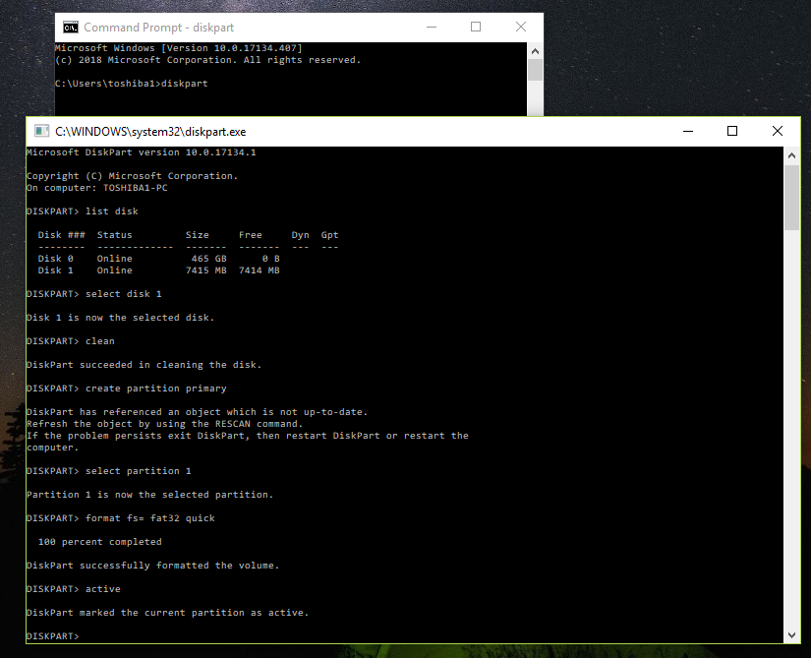

Slide 33
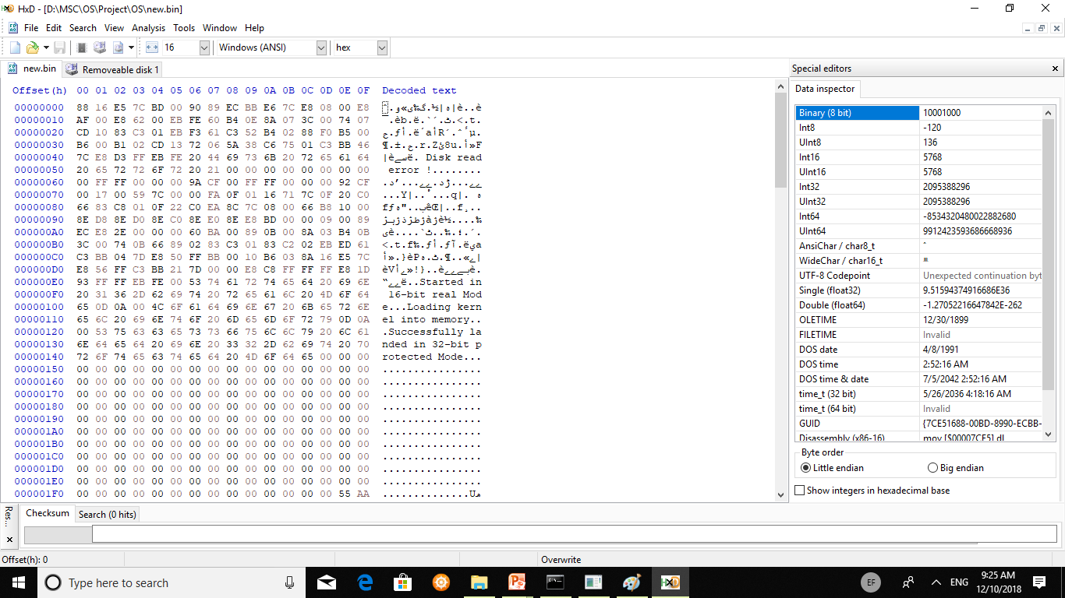
HxD

Slide 34
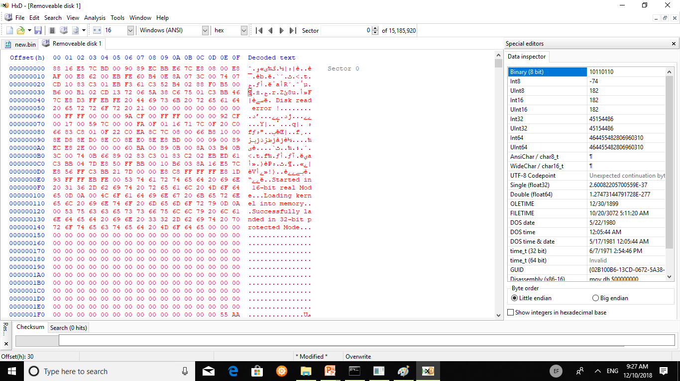
Cont.

Slide 35
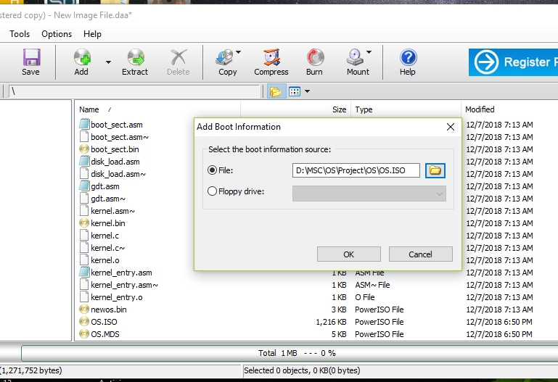
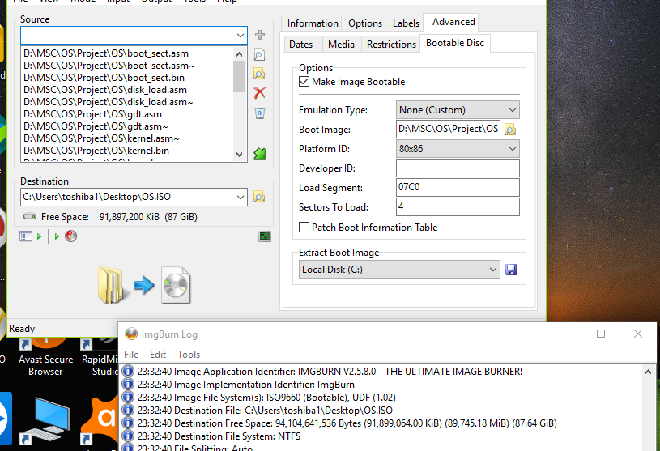
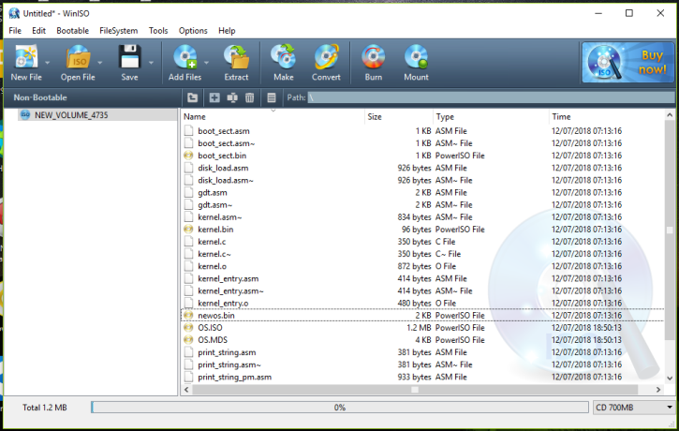
Cont.
ImgBurn, PowerISO and WinISO

Slide 36

Any Question
Thank you

